Slide 1
Understanding the three branches of State
Key Stage 3 & 4

Slide 2

State
Eg...law
Notes:
Brainstorm the word ‘government’? List all answers given by students on the white board. Reflect the key concepts mentioned.

Slide 3
The group of people with the authority to govern a country or state
Government
In order to keep law and order the nation, governments perform three vital functions

Slide 4


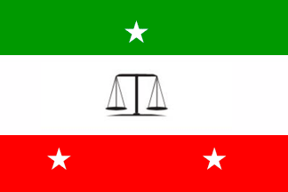

What are their roles?
The three branches of State
Legislature
(making laws)
Executive
(enforcing laws)
Judiciary
(interpreting laws )

Slide 5
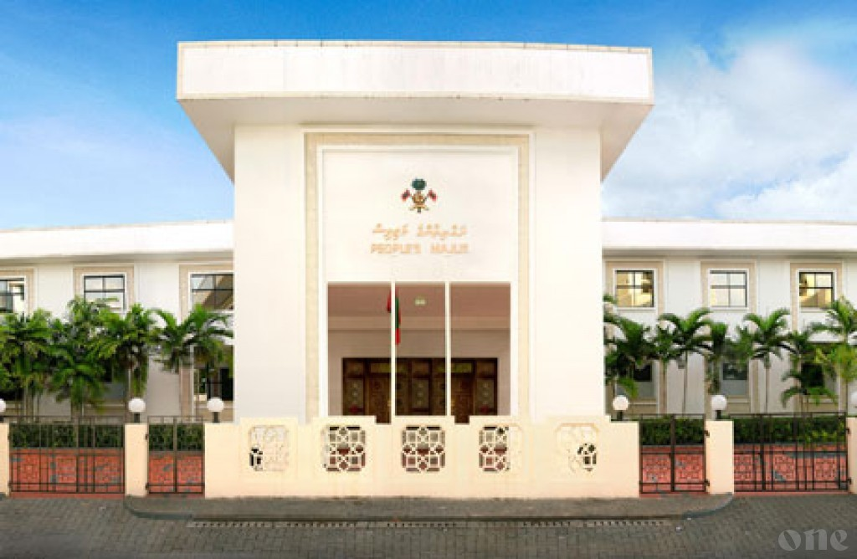
Legislature
Body that makes, amends and repeal laws.
The People's Majlis has legislative authority in the Maldives.
The legislature consists of Members of Parliament (MPs).

Slide 6
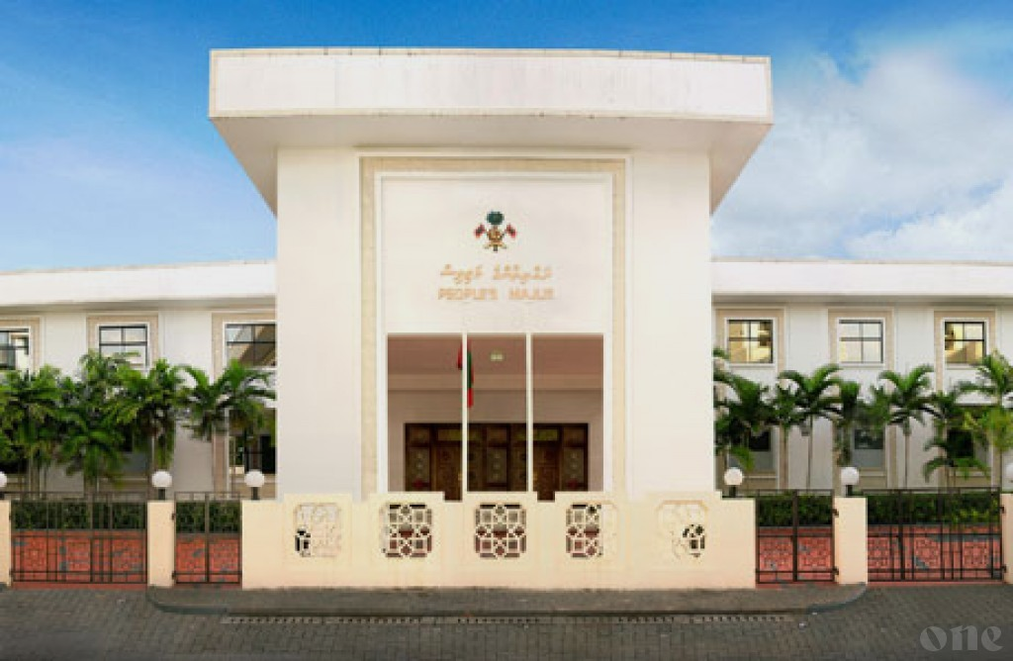
What are the powers of the Legislature?
Some of the powers listed for the legislature (People's Majlis) under Chapter III of the Constitution include;
amendment of the Constitution in accordance with the terms provided
adoption of laws or the revision or repeal of any legislation, provided that it does not conflict with any Islamic principles
making sure the authority is responsible for the use of its powers, and taking the necessary actions to guarantee the same
approval of the annual budget and any supplementary budget

Slide 7
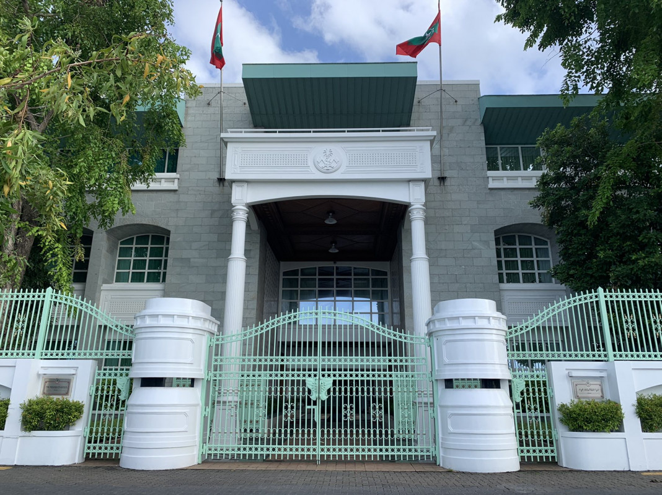
Executive
Responsible for governing the country in accordance with the laws passed by the Parliament.
In Maldives the executive function of the government is carried out by the President, who is the head of state.

Slide 8
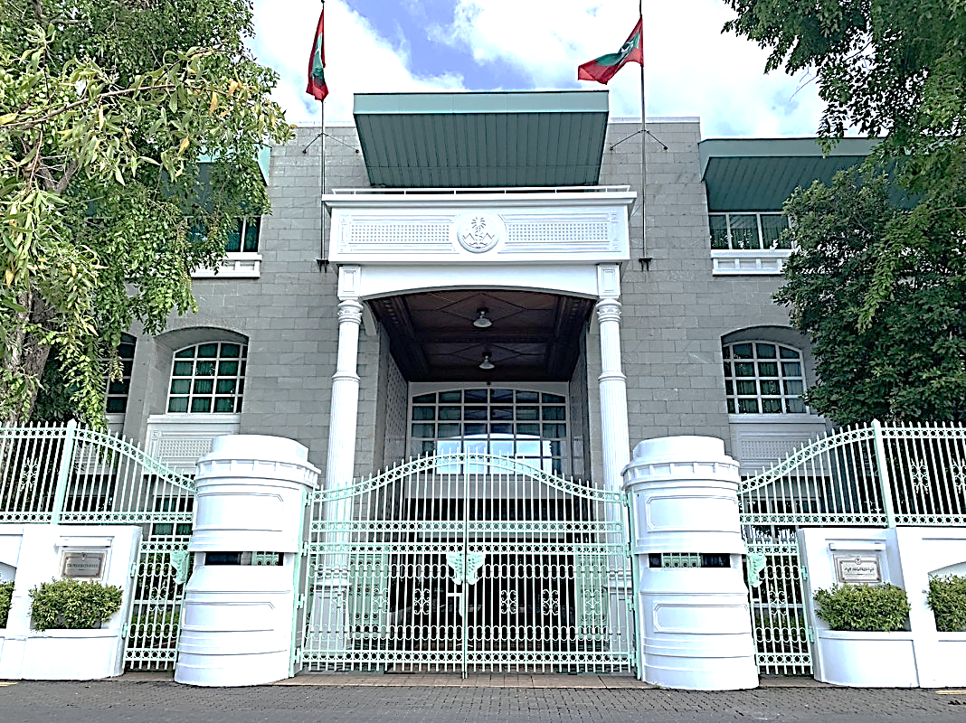
What are the powers of Executive?
selects the Cabinet
formulate major policy and legislative proposals.
establish, manage, and supervise the nation's foreign policy
manage political ties with other countries and international organizations;
proclaim situations of emergency
appoint members of diplomatic missions
appoint the Chief Justice, judges of the courts
Notes:
; similar to many presidential democracies, the Parliament must approve each cabinet member
compliance with the Constitution's provisions;
to foreign countries and international organizations in consultation with the People’s Majlisin

Slide 9
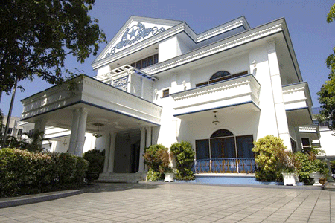
Judiciary
Responsible to interpret laws and regulations made by the legislature and government.
Notes:
It is their duty to guarantee that the nation's Constitution is followed in maintaining peace and order.

Slide 10
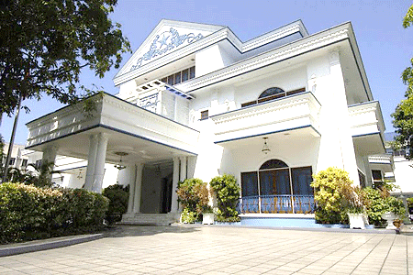
What are the powers of Judiciary?
Courts can say that any law or action that goes against the Constitution is not valid.
They can also make fair and sensible orders to fix the problem.
If a law is found to be invalid, they can stop it from being enforced right away.
Notes:
or action of any person or body carrying out a public function that violates the Constitution to the extent of the violation
such as; an order that suspends the declaration of invalidity (of a statute, regulation, or action due to inconsistency with the Constitution) for any period of time and under any conditions, allowing the competent authority to correct the defect;
thereof, order, judgment, or conduct of any individual or organization carrying out a public role that violates the Constitution

Slide 11
Separation of Powers
Legislature
(making laws)
Executive
(enforcing laws)
Judiciary
(interpreting laws )
Why is it important?

Slide 12
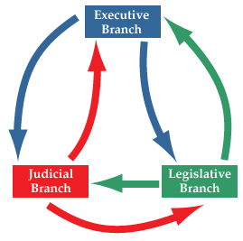
Separation of Powers is important
In order to prevent any one party from holding all the authority.
to hold distinct authority so that they can function as mutually reinforcing
checks and balances each other.

Slide 13


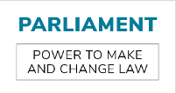
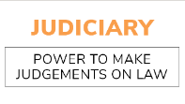
How does the Maldivian Constitution ensure the check and balance of powers among these three organs of the State?

Slide 14
Activity

Slide 15
Next step
Remember and Understand
Work in small groups
  sort out the powers into three groups executives, legislators, and judiciary
Executives | Legislators | Judiciary

